Slide 1
Ontario District St. Mary Event
April 9 - April 10, 2022
This information can also be found: https://www.firstroboticscanada.org/frc/StMaryfrc/agenda/

Slide 2
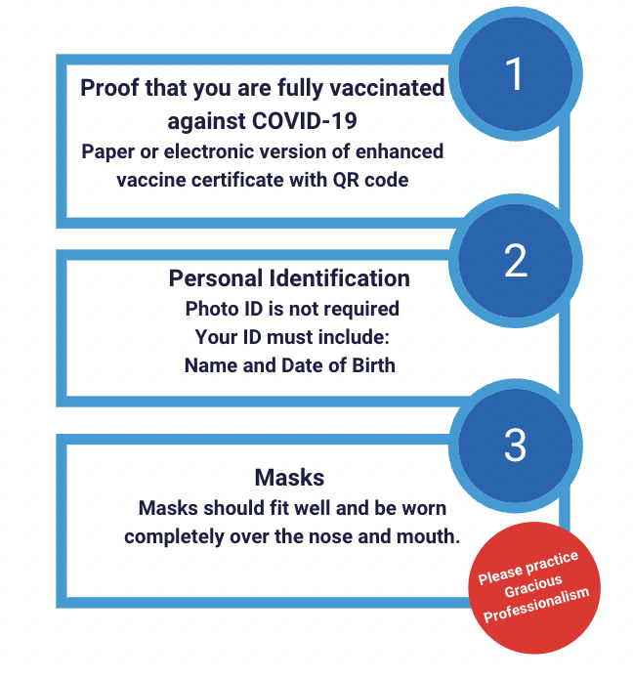
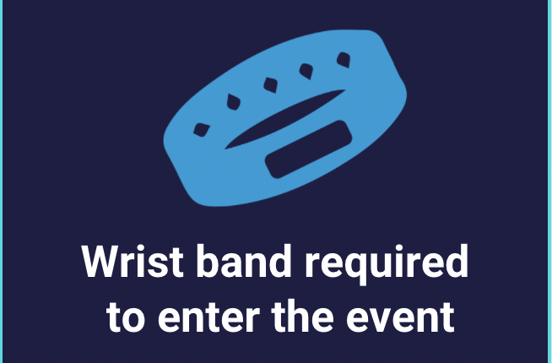
2022 St. Mary Event - Safety
Notes:
Karthik

Slide 3
2022 St. Mary Event
https://www.firstroboticscanada.org/frc/StMaryfrc/
Prior to the Event
Capacity - Team Roster & Attendance
Judging Schedule
Virtual Drivers Meeting
Match Schedule
At the Event
Registration and Load In
Practice Field and Machine Shop
Team Lunches, Quiet Room

Slide 4
2022 St. Mary Team capacity
Capacity Limit: 15 team members
Roster and Team Attendance
Wristband entry for Load In and Event Days
Entrances and Process
Address: St. Mary Catholic Secondary School - 200 Whitney Ave, Hamilton, ON L8S 2G7
Parking - free for participants.
Entry Points (map on upcoming slide):
Load in: Cafeteria Doors
Main event entrance: Doors near gymnasium
Notes:
Arti

Slide 5
2022 St. Mary Judging and Awards
All Judging is being done remotely
Pit Interviews are scheduled for
Monday - April 4 (25 mins)
Wednesday - April 6 (~10-15 mins)
Awards will be done remotely on April 12
Tune into twitch.tv/FIRSTCanada
Notes:
Arti

Slide 6
Virtual Drivers Meeting & Inspections
Virtual Drivers Meeting on
Thursday, April 7 @ 6:00 pm ET
Email will be sent to the teams to teams to submit questions for the
FTA, Head Referee, Lead Robot Inspector
Remember to complete your robot inspections prior to the event https://firstfrc.blob.core.windows.net/frc2022/Manual/2022-inspection-checklist.pdf
Notes:
Dave

Slide 7
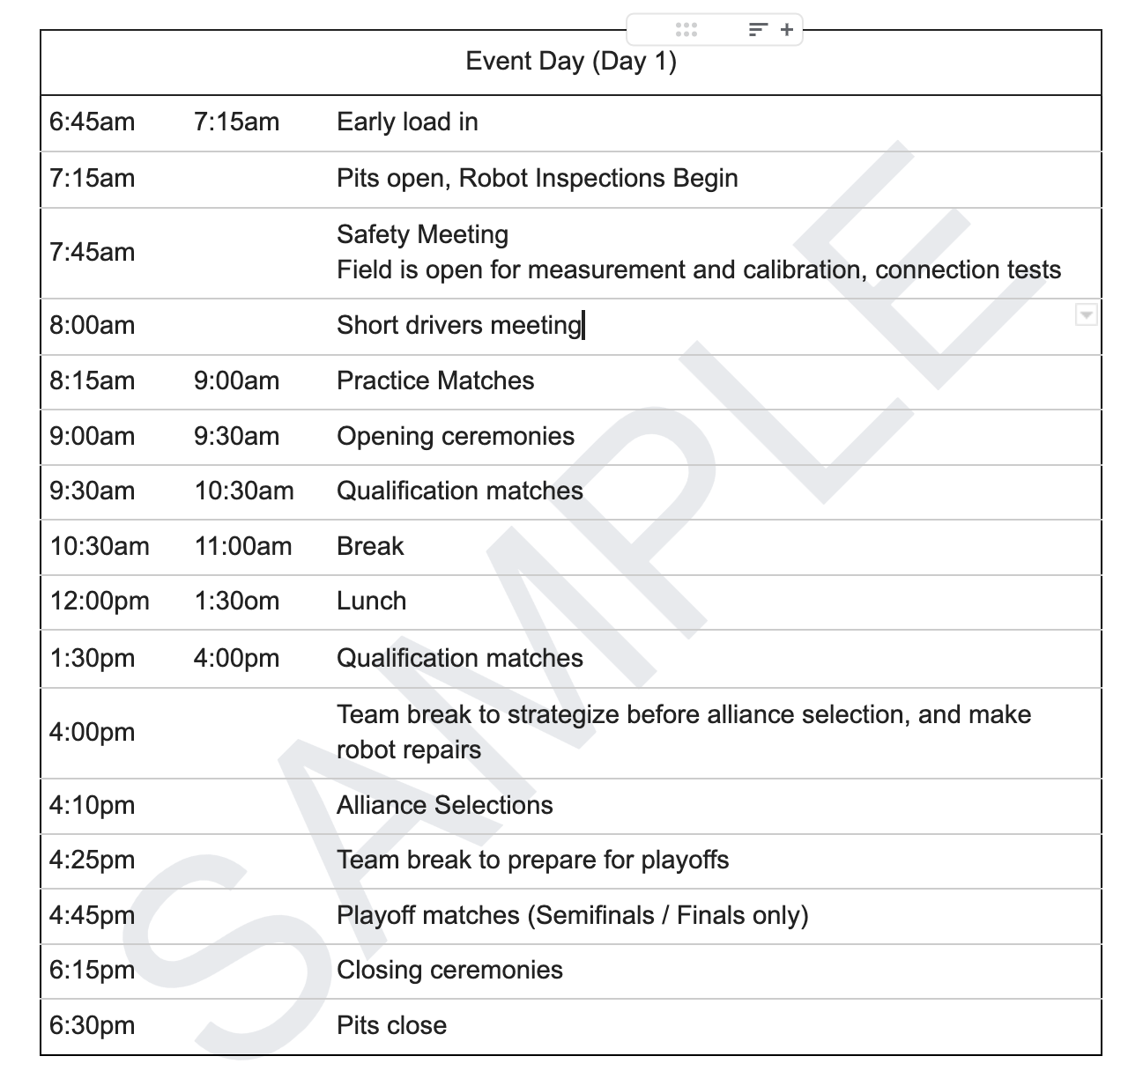
Match Schedule Sample
https://firstfrc.blob.core.windows.net/frc2022/Manual/2022FRCGameManual.pdf

Slide 8
Alliance Selection - 1 Day Events
FRC Field
1
3
5
18
6
17
7
16
8
15
9
14
10
13
11
12
2
4
https://firstfrc.blob.core.windows.net/frc2022/Manual/2022FRCGameManual.pdf
LEGEND
=
Emcee
=
Team Rankings
#’s
=
Teams

Slide 9
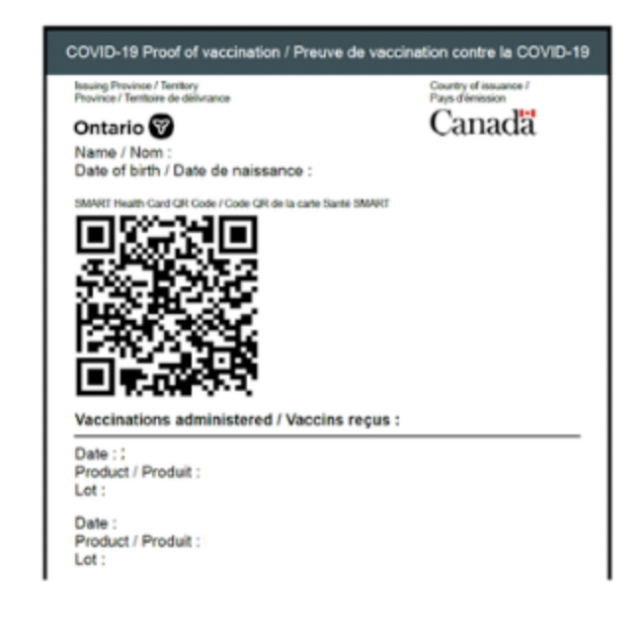
Registration and Load-In
To help speed up registration
Have your QR code and ID ready
It can be downloaded here.
YOU SHOULD BE ON TEAM ATTENDANCE LIST AND ON TEAM ROSTER
FOR LOAD IN:
Five team members get wristbands at the load in entrance
Drivers must remain in the vehicle at all times during load in
5 members in total only for load in (1 must be an adult)
COMPETITION DAY :
Load in team members (morning load in): Proceed to the load in entrance
All other participants (including previous evening’s load in teams): Proceed to the main entrance
Please see the map on the next slide
Notes:
Arti

Slide 10
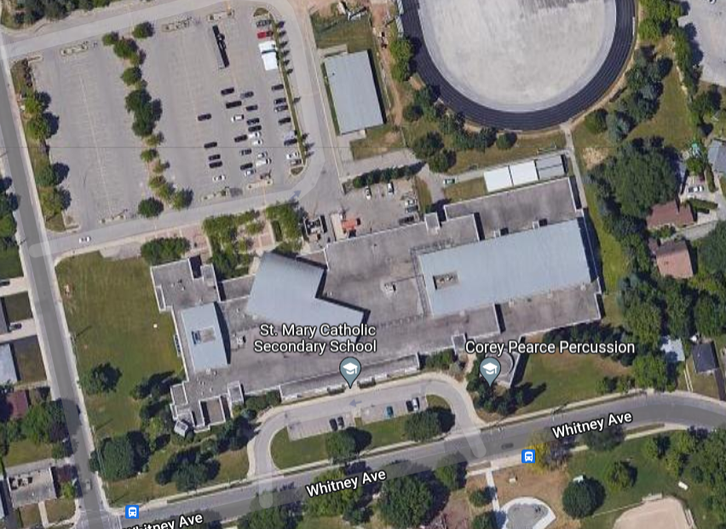
Registration and Load In
Main entrance
Load in
Load out
Notes:
Arti

Slide 11
Robot Field and Machine Shop
Practice Field Timings
Saturday
7:15 am - 6:00 pm
6:30 pm - 8:30 pm (only teams competing on both days at this event)
Sunday
7:15 am - 6:00 pm
Machine Shop Timing:
Fri.: Load In Day: 6:30 pm - 8:30 pm
Sat.: Team Competition Day 1: 7:15 am - 8:30 pm
Sun.: Team Competition Day 2: 7:15 am - 6:00 pm

Slide 12
2022 St. Mary Reminder Overall Schedule
Monday, April 4 PIT Interviews
Wednesday, April 6 PIT Interviews!
Thursday, April 7 Virtual Drivers’ Meeting 6pm ET
Friday, April 8 Load In for Teams
Saturday, April 9 Load in for Friday teams (6:45 am-7:30 am) Competition Day Load in for Saturday Teams (6:30 pm - 8:30 pm) PITS close and Load out Friday teams (6:30 pm)
Sunday, April 10 Load in for Saturday teams (6:45 am-7:30 am) Competition Day Pit close and Load Out (6:30 pm)

Slide 13
Team Spaces
Lunch Area designated for Teams: Classroom assigned
Quiet Room
Reminders!
No eating in pits/competition areas
No buffet/warmers/crockpots in team eating spaces or anywhere in venue
Please respect the space
Demonstrate our Gracious Professionalism to our host venue
Join the Ontario Team Support Slack group!

Slide 14
Thank you!
Looking forward to seeing you at St. Mary!
St. Mary Event
April 8 - April 10, 2022

